Slide 1
Project 4
Group 8
Mehmet Cingoz
Lavenya Mohanasundaram
Nicholas Voltin

Slide 2

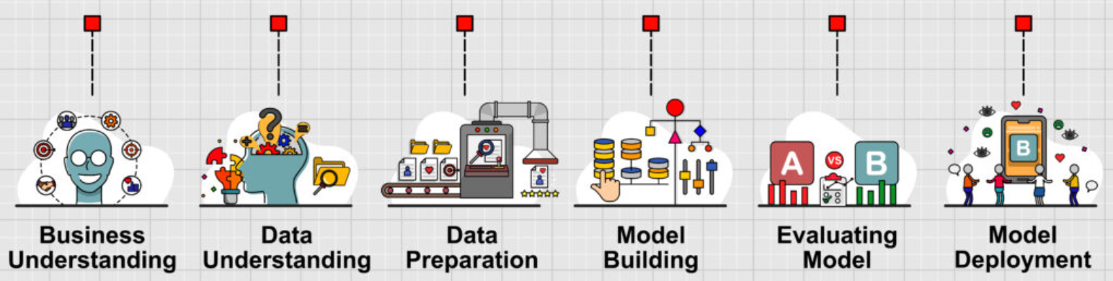
What we did
Notes:
Nicholas

Slide 3
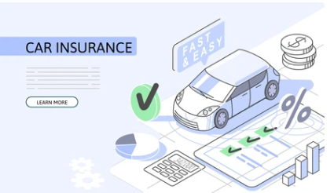
Business Understanding
Data Understanding
Data Preparation
Model Building
Evaluating Model
Predicting Future Loss Claims for Car Insurance Households
In the insurance industry, predicting future claims is crucial for risk assessment and pricing strategies.
This project focuses on creating a predictive model that predicts whether an insurance applicant will file a claim in the future based on their loss history and application data.
Notes:
The objective of this project is to integrate these datasets to construct a robust model that can predict future claims based on the information known at or before the application date. The process involves aggregating the claim data to quantify the claim frequency per household, merging this with the application and subsequent loss data, and then applying machine learning techniques to predict future claim occurrences.
By accurately predicting future claims, insurers can improve their risk management processes, tailor their customer interactions, and optimize their financial outcomes. The end goal is to enhance decision-making processes, leading to more informed underwriting and reduced financial risks.
Nicholas

Slide 4
Business Understanding
Data Understanding
Data Preparation
Model Building
Evaluating Model
The model leverages three distinct datasets:
Claim Data
Predictor Data
Contains comprehensive information gathered from insurance applications. This dataset provides insights into the demographics and other relevant details of households as of the application date, January 1, 2017.
Subsequent Loss Experience
Encompasses data on the loss experience of the applicants for one year following their application. This includes any claims filed after the application date.
This dataset includes detailed records of claims filed by existing policyholders. Each record details whether a claim was made by a driver within a household and categorizes the claims as either 'At Fault' or 'Not At Fault.'
Notes:
Nicholas

Slide 5

Business Understanding
Data Understanding
Data Preparation
Model Building
Evaluating Model
Aggregate claims data by household ID.
Calculate fault and not at fault claims for the last five years.
Clean data by removing unnecessary columns before export.
Merge datasets to create a comprehensive dataset.
Handle missing values effectively to maintain data integrity.
Data Preparation
Notes:
Lavy

Slide 6

Business Understanding
Data Understanding
Data Preparation
Model Building
Evaluating Model
Feature Engineering
Data Cleaning
Removed unnecessary variables to streamline the dataset.
Feature Selection & Engineering
Selected 20,000 observations and 44 key features for predictive modeling.
Model Preparation
Defined Features (X): Selected variables from the cleaned dataset.
Defined Target (Y): future_clm_ind (binary outcome for future loss occurrence).
Imputed Data with Mean & Median
Identified and handled missing values effectively.
- Feature selection is vital for successful modeling.
Derived Features:
fault_claims & not_at_fault_claims → Claim history indicators.
loss_ratio → Created to capture risk assessment.
Notes:
Lavy
Prepare and refine the dataset for predictive modeling to determine if an applicant will have a future insurance loss (future_clm_ind). The target variable indicates future loss occurrences.
Checked Missing Values & Handled Missing Data:
Identified missing data in key features:
time_w_carr (35% missing) → Imputed with median
prior_bi (35% missing) → Imputed with median
veh_lien_cnt (99.9% missing) → Dropped due to excessive missing values
credit_score (4.6% missing) → Imputed with mean
Ensured no missing values remained in the final dataset.

Slide 7
Understanding Predictive Modeling in Car Insurance
Business Understanding
Data Understanding
Data Preparation
Model Building
Evaluating Model
Predictive modeling uses historical data to forecast future events. Insurance companies benefit from identifying potential claimants. Key factors include loss history and demographic information. Improved pricing strategies can enhance profitability.
K-Nearest Neighbors is effective for classification tasks.
Decision Trees provide clear decision-making paths.
Support Vector Machines excel in high-dimensional spaces.
Logistic Regression is useful for binary outcome predictions.
Algorithms Used
Notes:
Data Preparation:
The dataset Featureed_DS_SF.csv was split into training (80%) and test (20%) sets.
Feature scaling was applied using StandardScaler.
Training Process:
Each model was trained on the training set (X_train, y_train).
Predictions were made on the test set (X_test).
The best hyperparameters were selected (e.g., k for KNN).
Lavy

Slide 8
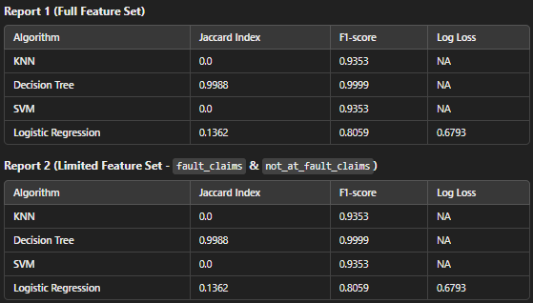
Business Understanding
Data Understanding
Data Preparation
Model Building
Evaluating Model
Notes:
Key Observations
Decision Tree performed best with:
Jaccard Index = 0.9988
F1-score = 0.9999
High accuracy with limited features.
KNN and SVM had poor Jaccard scores (0.0).
Both models performed similarly in F1-score (0.9353), indicating they might be biased towards the dominant class.
Logistic Regression performed reasonably well:
Jaccard Index = 0.1362
F1-score = 0.8059
Log Loss = 0.6793 (better probabilistic calibration).
Feature Selection Did Not Significantly Change Results:
Report 1 and Report 2 had nearly identical scores, meaning the additional features did not drastically improve performance.

Slide 9
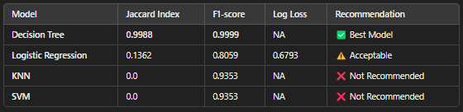
Business Understanding
Data Understanding
Data Preparation
Model Building
Evaluating Model
Model Summary & Recommendation
Notes:
✅ Decision Tree is the best model for predicting future claims due to high accuracy and interpretability. → Recommended for deployment.
⚠️ Logistic Regression is a reasonable alternative if probabilities are needed. → Acceptable alternative, but not the best.
❌ KNN & SVM performed poorly, making them unsuitable for deployment. → Not recommended.
Feature selection had minimal impact

Slide 11
Appendix

Slide 12
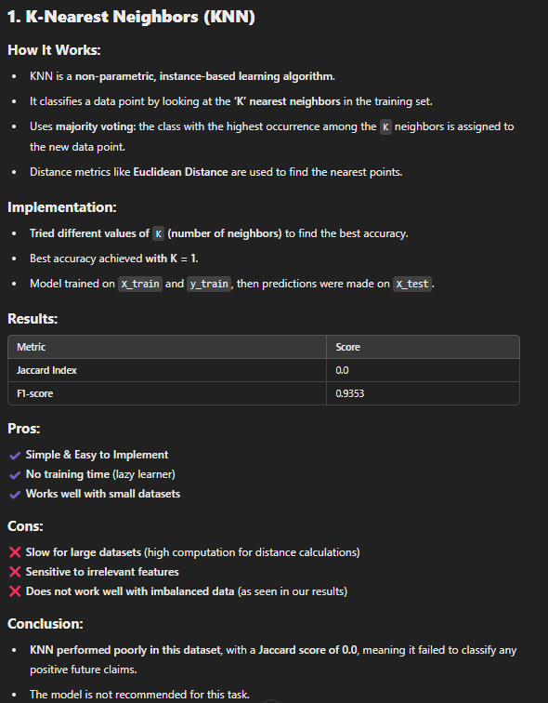

Slide 13
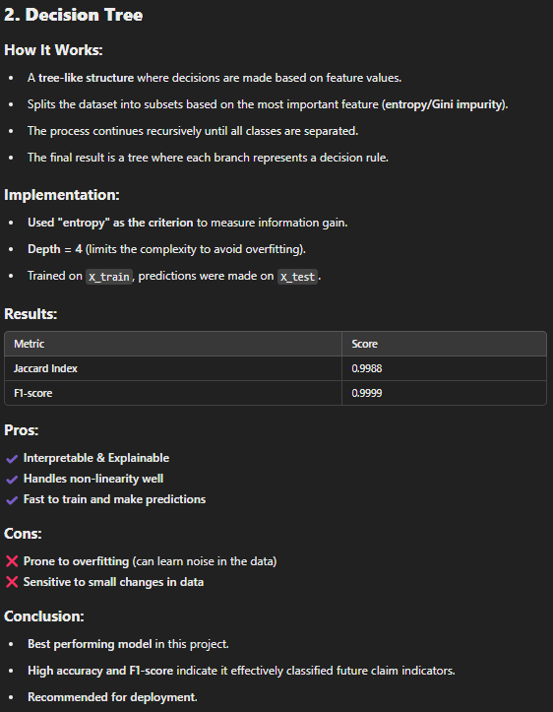

Slide 14
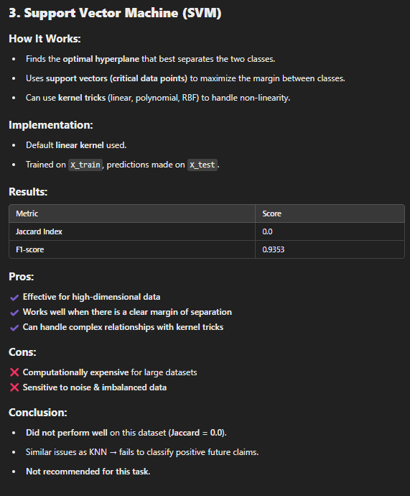

Slide 15
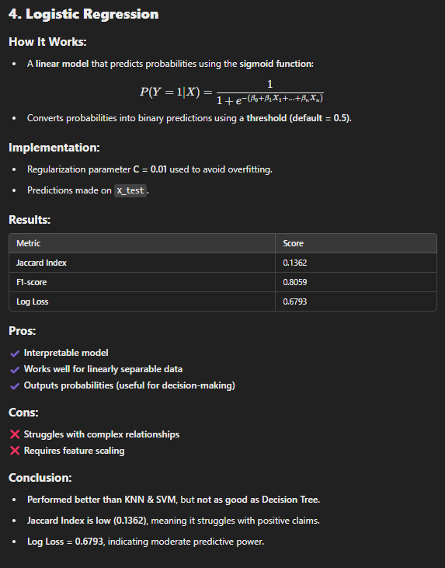

Slide 16
Business Understanding
Data Understanding
Data Preparation
Model Building
Evaluating Model

Slide 17
Business Understanding
Data Understanding
Data Preparation
Model Building
Evaluating Model

